Slide 1
K9 Backhand Service

Slide 2





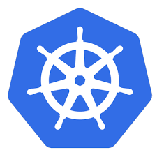



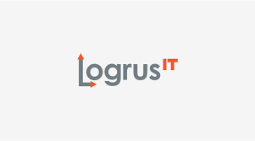


Technologies
go-openapi
go-dep
go-lint
sqlx
migrage
spf13-viper
k8s.io
api
apiserver
apimachinery
client-go
kube-openapi
metrics
cli-runtime
kubernetes-1.11.1
terraform
docker
ghodss-yaml
sirupsen-logrus
stretchr-testify
stretchr-mock
helm

Slide 3
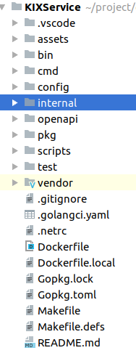
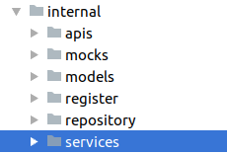
Code Style
Reference
https://github.com/golang-standards/project-layout

Slide 4
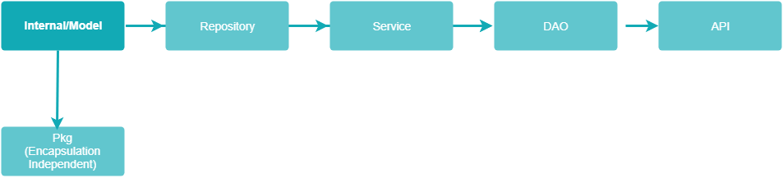
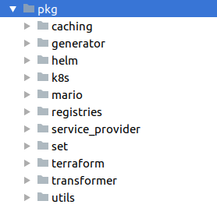
Data Flow

Slide 5
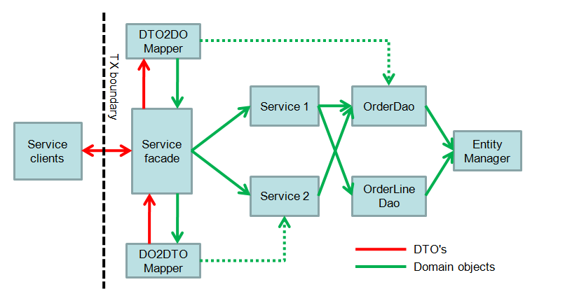
Problem
Service DAO boundary unclear
Service façade not exist
IOC ugly

Slide 6
K9 Feature Now Create and Import Cluster On-board application Trigger Pipeline Promote Images Deploy Create release train Drive release train

Slide 7
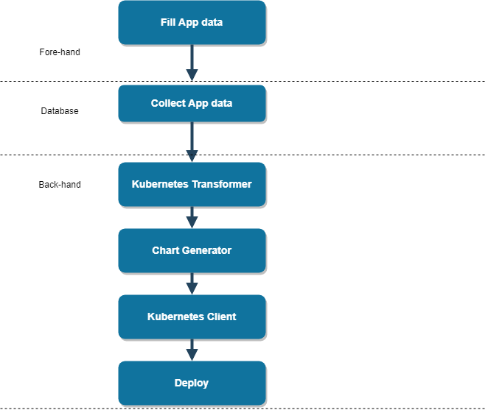
Deploy services from front-end to Real Kubernetes

Slide 8
Wheel – Kubernetes Transformer
Translates K9 meta data into Kubernetes resources runtime
Well defined interface so it is easy to write new stage and plug it in.
Loader
Load K9 Meta data to KubernetesConfig
Transformer
Takes KubernetesConfig and converts it to sets of Kubernetes objects
Outputter
Takes Transformer result and converts it to stdout or json/yaml

Slide 9
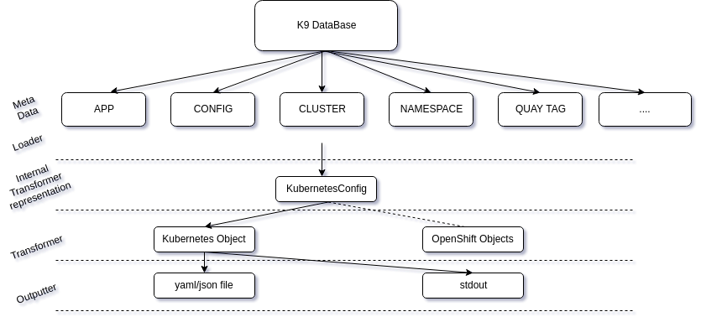
Transformer Framework

Slide 10
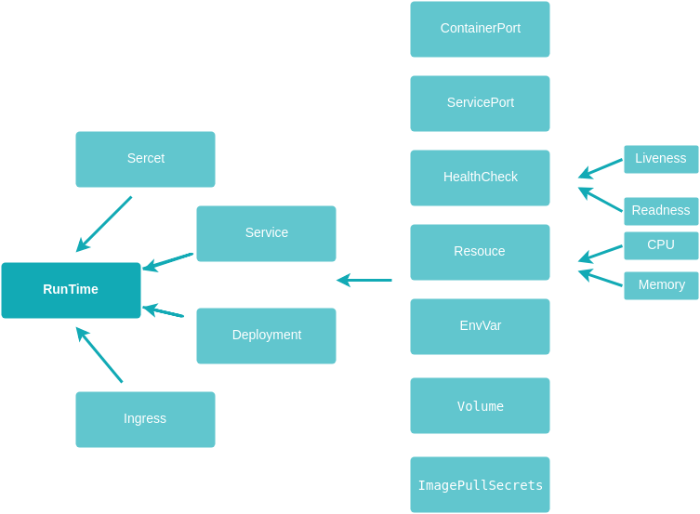
Transformer Support

Slide 11
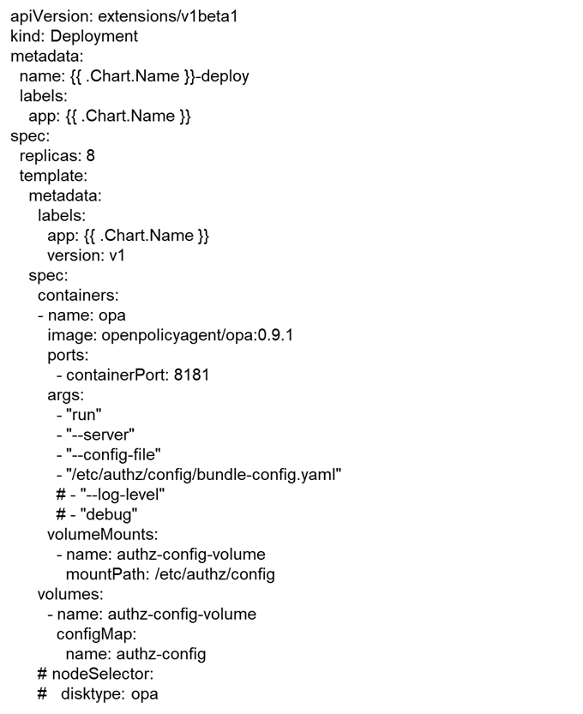
Transformer Advantage
Flexible
Safe
New required:
No need to create additional struct to serialize, just set the args value

Slide 12
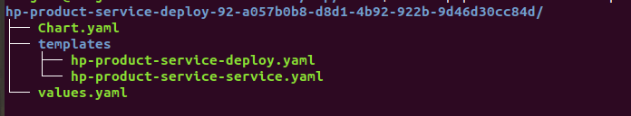
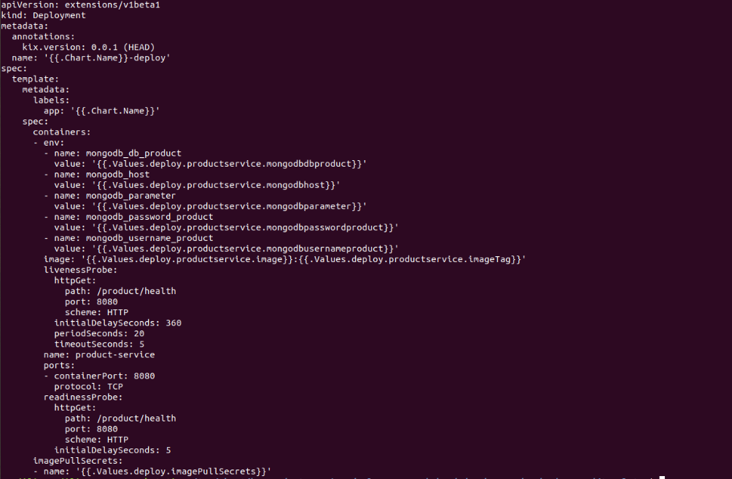
Wheel – Chart Generator
Generate Helm Charts from Kubernetes objects
Chart Generator will read objects from Transformer output
output

Slide 13
Principle
Define Template
DeploymentTemplate
ServiceTemplate
SecretTemplate
TODO
Generated chats need upload to Github/s3
Use Helm Chart Repository

Slide 14
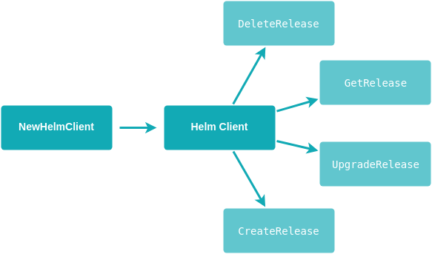

Wheel-Kubernetes Client
Optimization:
helm client cache pool

Slide 15
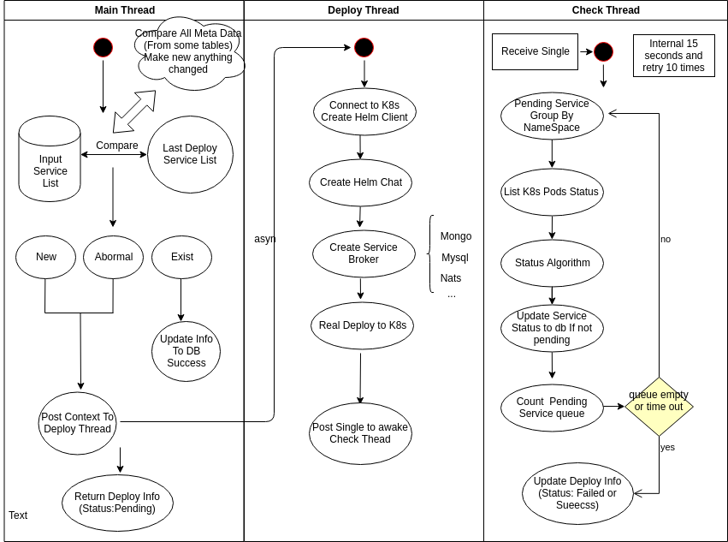
Wheel- B nasic Deploy

Slide 16
End

